Slide 1
Last Name
GBL #

Slide 2
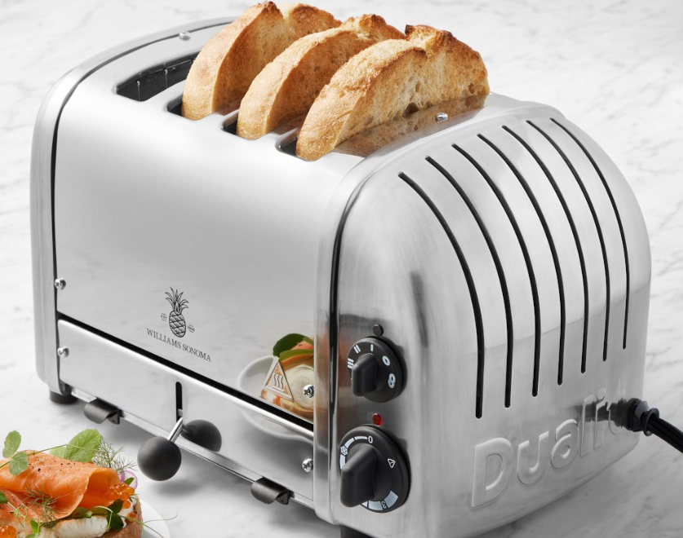
#17 – Williams Sonoma Dualit Toaster
EXAMPLE
Description of Item – Williams Sonoma Dualit Classic 4-slice Toaster that includes the defrost function, extra wide slots, and bagel setting.
Description of Damage – Toaster no longer heats up when plugged in and turned on
Item Cost – $379.95
Shipping Cost – Free
Tax Cost – $22.80
Other Information - Model is compatible with Dualit sandwich cage and warming rack. Toaster is the 70th Anniversary Edition
Link - Dualit 70th Anniversary 4-Slice Toaster | Williams Sonoma
EXAMPLE

Slide 3
Inventory # - Item Name
Description of Item –
Description of Damage –
Item Cost –
Shipping Cost –
Tax Cost –
Other Information -
Link -

